Slide 1

Switching response modalities in picture naming
Aikaterini Tsaroucha
Supervisors: Svetlana Pinet, Clara Martin
27.09.2023

Slide 2

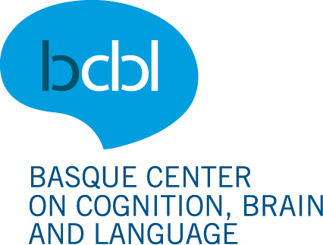
Background
Bonin et al. (2001)
Phonology – L1 written production (handwriting)
→ Phonology constrains the activation of orthographic representations and is co-activated during writing
Rastle et al. (2011)
Orthography – Oral production
→ Orthographic regularity affects naming
→ Orthographic representations are activated in oral production even when not required
Phonology
Orthography
(Luria, 1970; Scinto, 1986; Miceli et al., 1997)

Slide 3
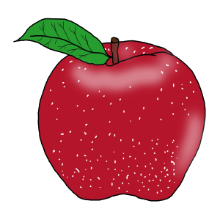
Motivation
Semantics
Semantics
?
?
Phonology
Orthography
Phonology
Orthography
SPEAK
WRITE

Slide 4


How to..?
Task switching paradigm (Philipp & Koch, 2011; Philipp & Koch, 2005)
Switch costs
Modality
Switch > Repeat
Modality effect on RTs
Vocal > Manual
Asymmetry of modality switching
Vocal > Manual

Slide 5



This experiment
task switching paradigm for modality switching in
oral and written language production
modality switching in typing
(Pinet et al., 2016)
co-activation of representations
level & strength
of co-activation of phonological and orthographic representations
(oral and typed naming)
(a)symmetry?

Slide 6

Methodology & Design
Response-modality switching (speak, type) in item-repetition picture naming.
45 di- & trisyllabic Spanish nouns (MultiPic, Duñabeitia et al., 2018)
32 nouns → picture naming task
7 nouns → practice sessions
6 nouns → extra fillers in the picture naming task
Cognate status (Basque, English), log frequency, mean token bigram frequency, no. letters, no. phonemes, no. syllables, bimanual transitions (%), semantic category
Imageability, visual complexity, name agreement

Slide 7


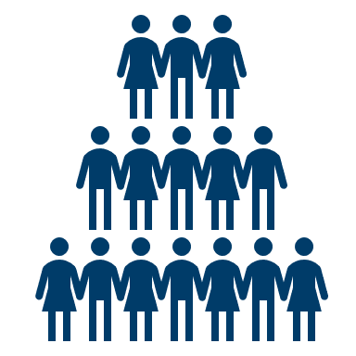
Methodology & Design
Participant profile:
N = 48
18-40 yo
Skilled typists
https://www.npr.org/sections/health-shots/2010/10/28/130893113/typing-errur-your-fingers-know-even-when-your-brain-doesn-t

Slide 8

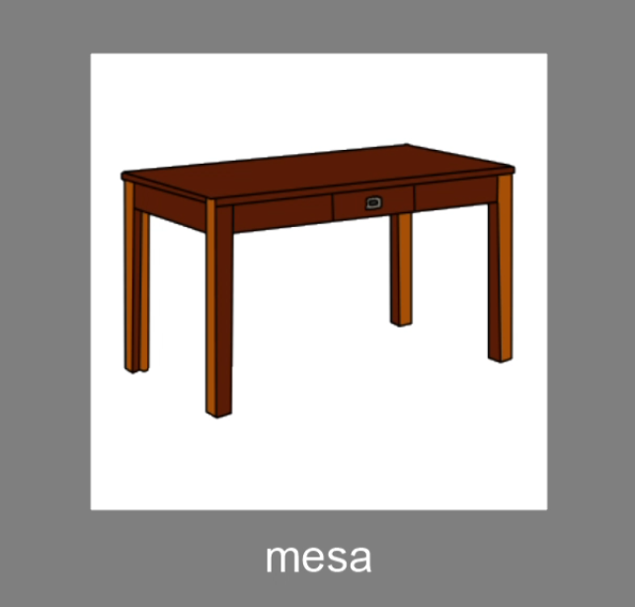
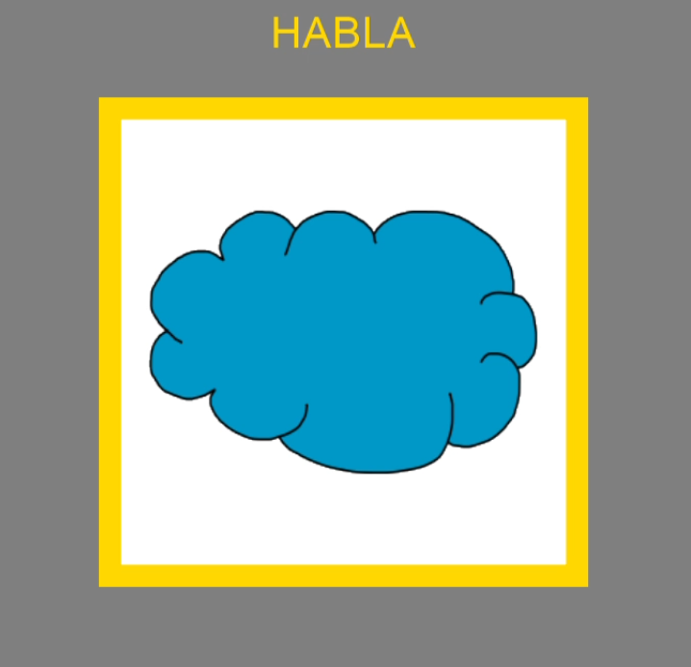

Methodology & Design
1 hour
Familiarisation
Practice 1
Practice 2

Slide 9

Methodology & Design
Picture naming task

Slide 10
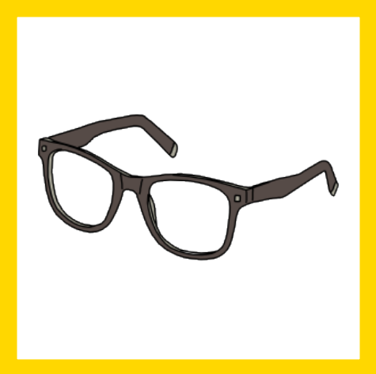
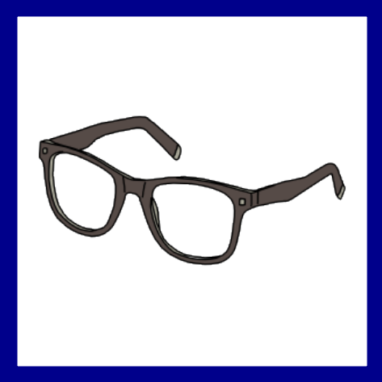
Methodology & Design
Repeat Speak (32)
Repeat Type (32)
Item repetition
Switch Type to Speak (32)
Switch Speak to Type (32)

Slide 11

Statistical Analysis
DVs: RTs, accuracy, duration
IVs: Condition (repeat, switch), Modality (type, speak)
Correct trials, 150-2500ms
Baseline RT in Speak and Type
Linear mixed-effects modelling:
Effect of Condition and Modality on RTs / durations
Generalised mixed-effects modelling:
Effect of Condition and Modality on accuracy
Random effects check

Slide 12
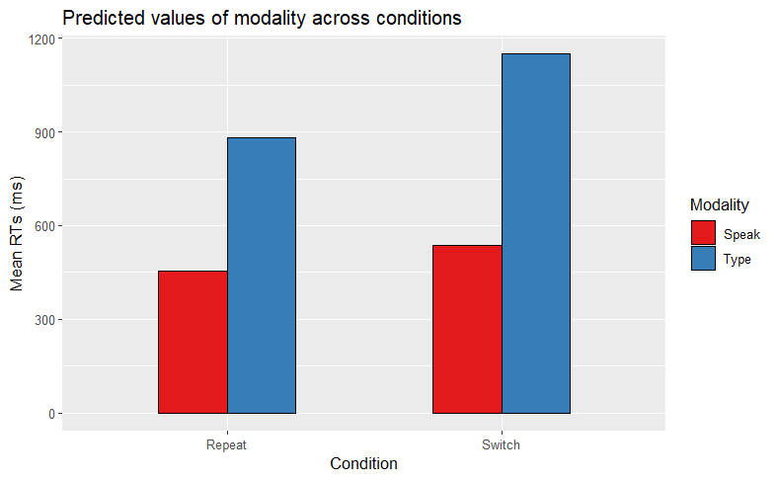
Predictions
Main effect of Modality on reaction times (RT ~ Modality)

Slide 13
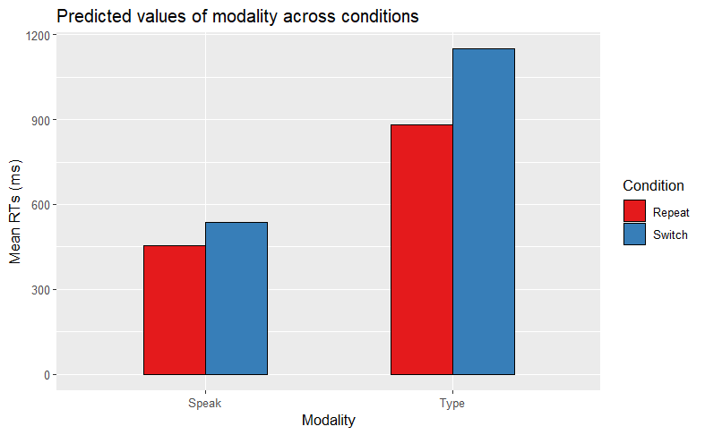
Predictions
Main effect of Modality on reaction times (RT ~ Modality)
***

Slide 14
Predictions
***
Main effect of modality on reaction times (RT ~ Modality)
Main effect of Condition on reaction times (RT ~ Condition)
***

Slide 15
Predictions
Main effect of Modality on reaction times (RT ~ Modality)
Main effect of Condition on reaction times (RT ~ Condition)
***
***

Slide 16
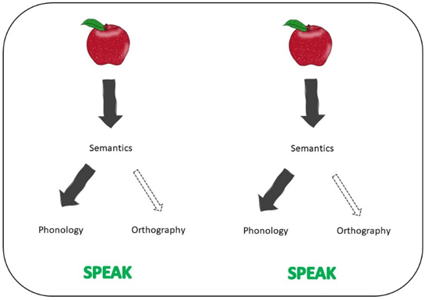
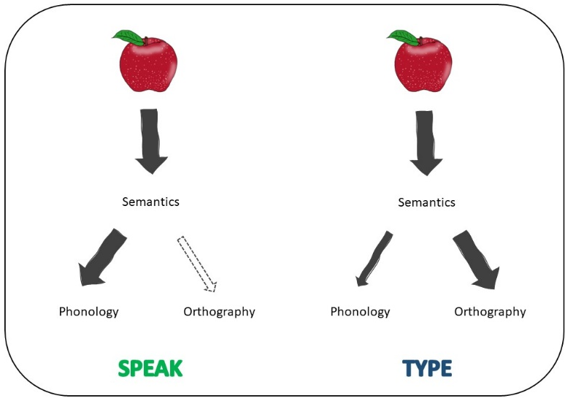
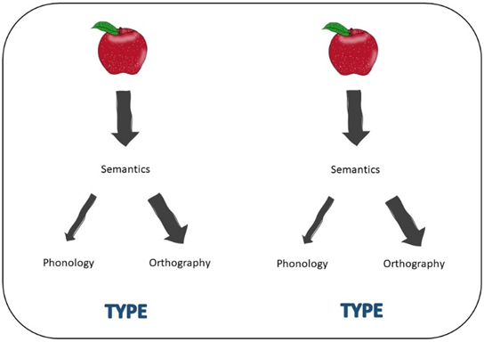
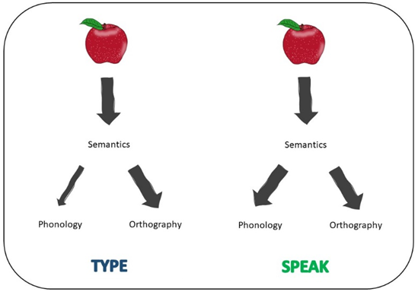
Predictions

Slide 17
Predictions
Interaction: RT ~ Condition * Modality
H1: If phonology is strongly co-activated when typing and orthography weakly co-activated when speaking, larger switch costs to typing than to speaking (for the same item) are expected (ΔS < ΔT)
H0: If orthography is also strongly co-activated when speaking (ΔS = ΔT), we do not expect larger switch costs to speaking than those to typing.
ΔT = 270ms
ΔS = 82ms

Slide 18
Predictions
ΔT = 270ms
Interaction: RT ~ Condition * Modality
H1: If phonology is strongly co-activated when typing and orthography weakly co-activated when speaking, larger switch costs to typing than to speaking (for the same item) are expected (ΔS < ΔT)
H0: If orthography is also strongly co-activated when speaking (ΔS = ΔT), we do not expect larger switch costs to speaking than those to typing.
ΔS = 82ms

Slide 19
Predictions
31%
ΔS / RepeatS = 18% slower to switch to Speak than repeat Speak
ΔT / RepeatT = 31% slower to switch to Type than repeat Type
18%

Slide 20
Methodology & Design
animal
pulpo, cerdo, vaca, caracol, conejo, pavo
body part
pierna, oreja, mano, espalda
clothes
camisa, traje, guante, falda
food
miel, manzana, fresa
job
bombero, cartero, pintor, cazador
place
baño, iglesia, granja, puente
object
muñeca, columna, vaso, tenedor, tronco, escoba, cadena, espejo, cuerda, taza, aguja, goma, regalo

Slide 21
Methodology & Design
 | Repeat | Switch
Target Speak | 32 | 32
Target Type | 32 | 32
256 trials + 152 fillers = 408 trials

Slide 22
Predictions

Slide 23
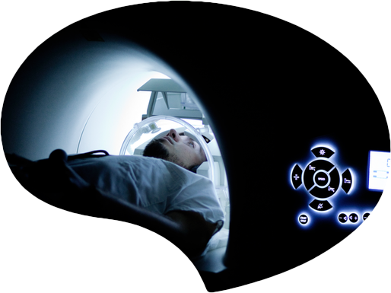
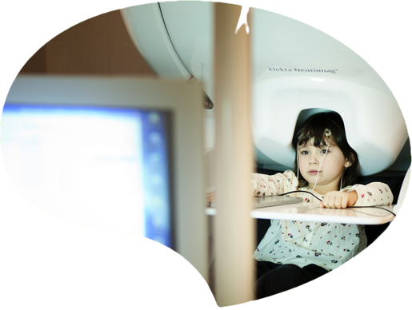
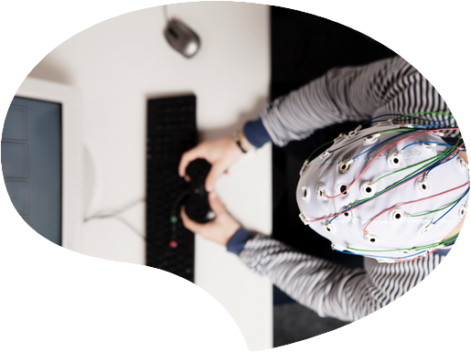
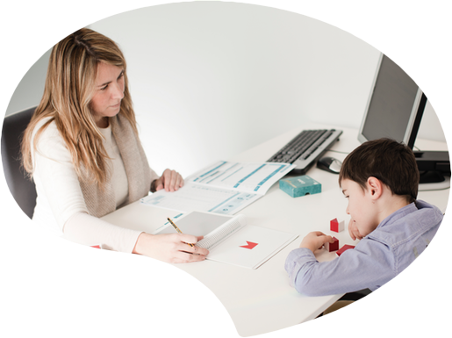
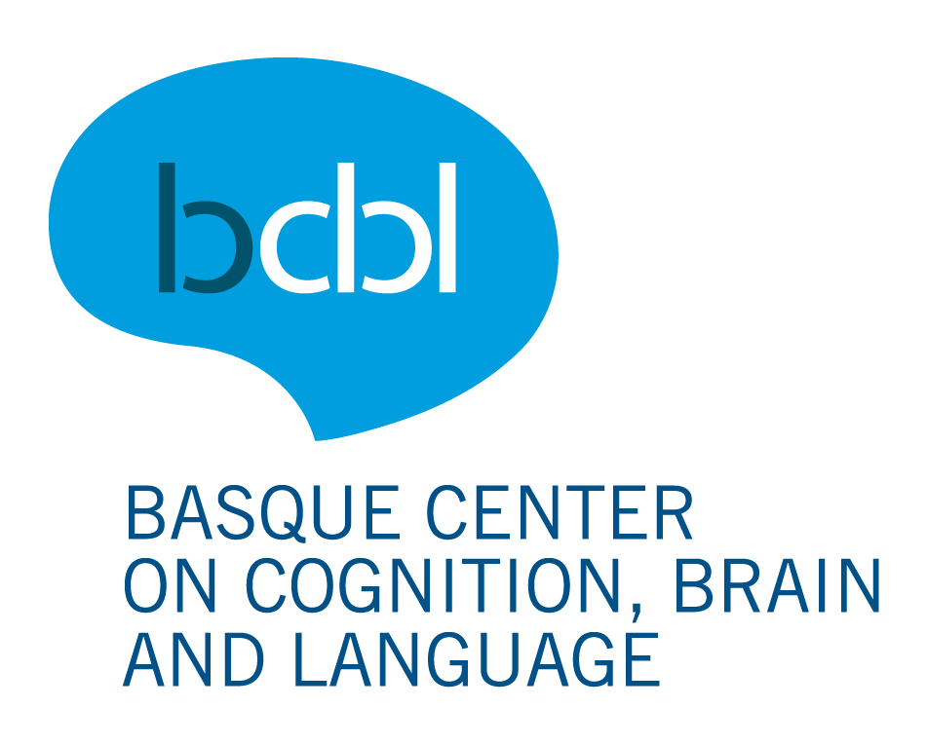

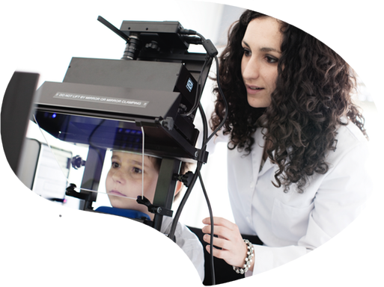
Preguntas?
Thank you!
Eskerrik asko!

